Slide 1
Telco Customer Analysis
April 29, 2025
Tiana Cofer
DATA 480

Slide 2
Contents
Introduction (01)
Data (02)
Methods (03)
Results (04)
Limitations (05)
Reflection (06)

Slide 3
Introduction
1.
2.
Research Question My formal research question is: Which customer segments have the highest churn risk? This was broken down into 3 sub-questions.
Which subscription plans are most associated with customer churn?
What customer behaviors serve as strong predictors of churn?
3.
Can we build a predictive model for churn?

Slide 4
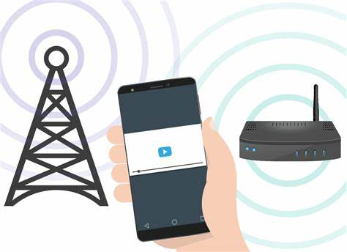
Data
Dataset
The data used was a fictional subscription service dataset called Telco.
It includes multiple subscription services, such as phone, internet, and device protection to name a few.

Slide 5
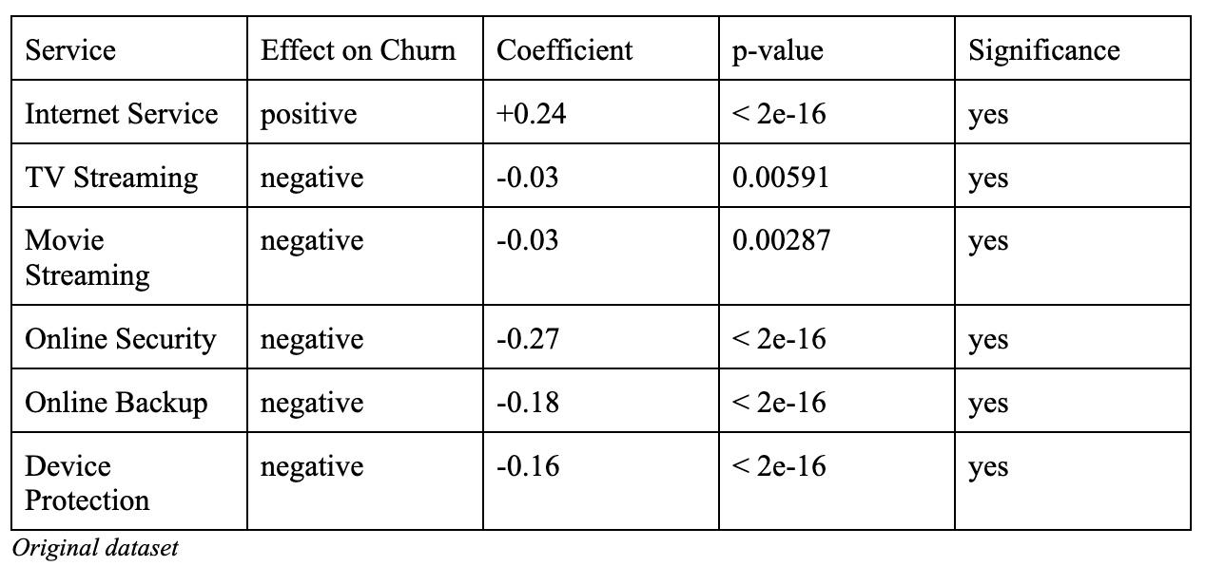
Methods
To evaluate the data, packages in R such as readr, tidyverse, and dplyr were used. The methods used to evaluate the data were:
Linear regression
Correlation
Logistic regression

Slide 6
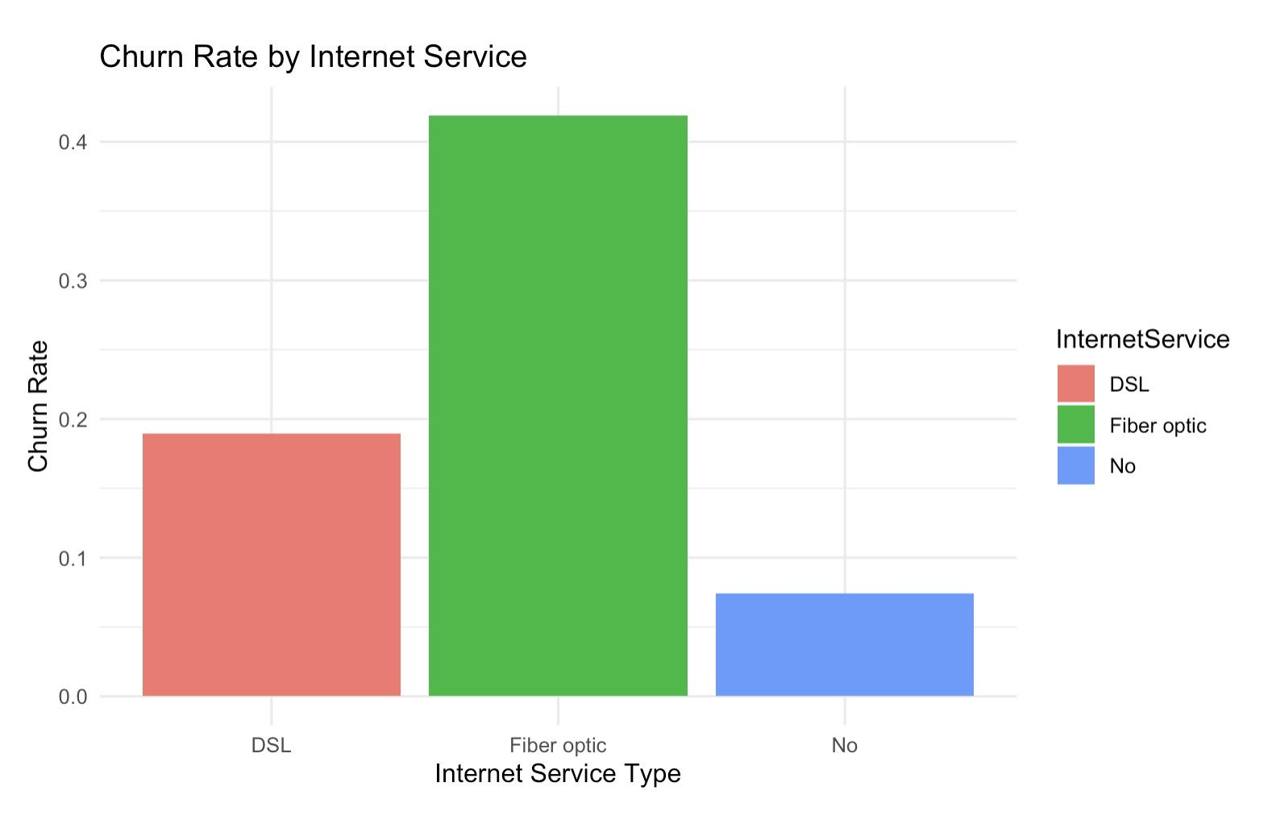
Results: Churn Rates by Service
We can see here that churn is much higher for customers with fiber optic internet, suggesting a potential problem with that service.

Slide 7
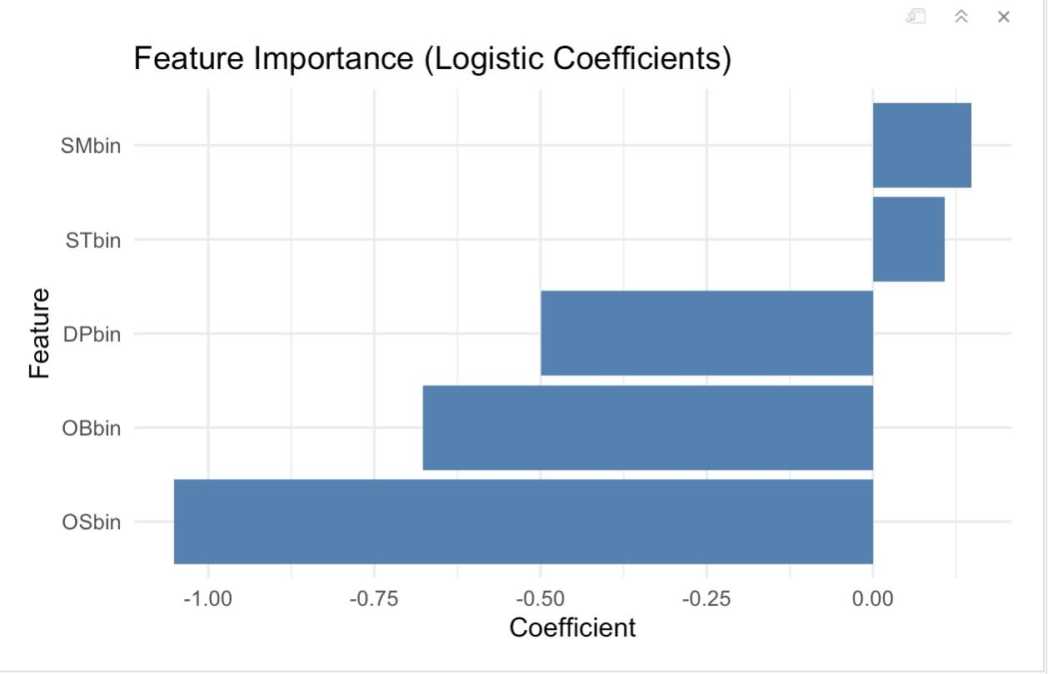
Results: Feature Importance
Positive bars show features that increase churn risk, while negative bars reduce it.
Results suggest customers want security and protection
Might be frustrated with internet quality or pricing.

Slide 8

Results: Model Performance
Model correctly predicted customer churn about 79% of the time.

Slide 9
Limitations
Data
The Telco dataset is fictional
The project had some limitations. Some of these included:
Fictional dataset
Short time span
One coding language
Time
4-month time limit
Tools
Only R coding language was used for analysis

Slide 10

Reflection
There many things I would redo if I had the time.
Smaller Dataset
I would pick a smaller dataset instead of one with 7,000 observations.
Machine Learning Models
I would also try and learn more machine learning models such as K-Nearest Neighbors to implement.

Slide 11
Thank you!

